Slide 1

Introduction to Xamarin
Kevin Ford
Mobile Practice Lead
Magenic
Level: Introductory

Slide 2
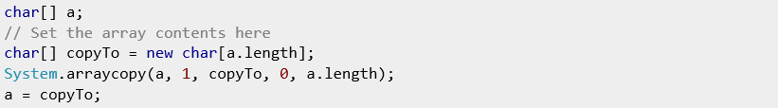
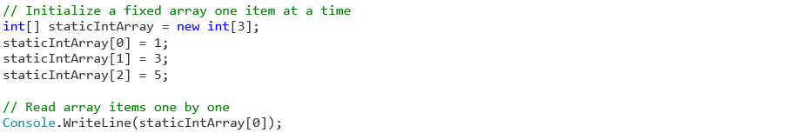
The Mobile Development Problem
iOS
Objective-C/Swift/Xcode
Android
Java/Android XML
WinRT
C# .NET/XAML
C++/XAML
Html5/JS
Windows Phone
C# .NET/XAML
C++/XAML
Html5/JS

Slide 3
Development Options
Mobile Enabled Web
Hybrid
True
Native
Near Native
HTML5/JS
Cordova
Xamarin
Java-Android
Objective-C/ Swift /iOS

Slide 4
Native User Interfaces
Native API Access
Native Performance
Notes:
Spin off of Mono.

Slide 5
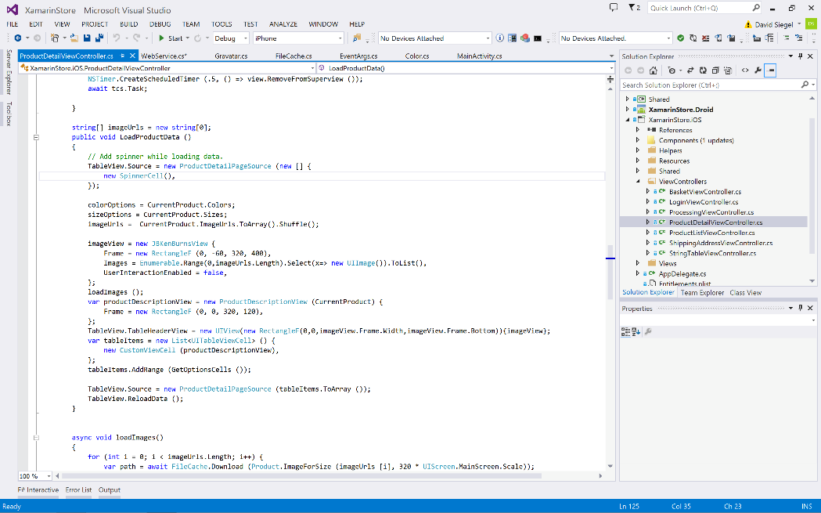
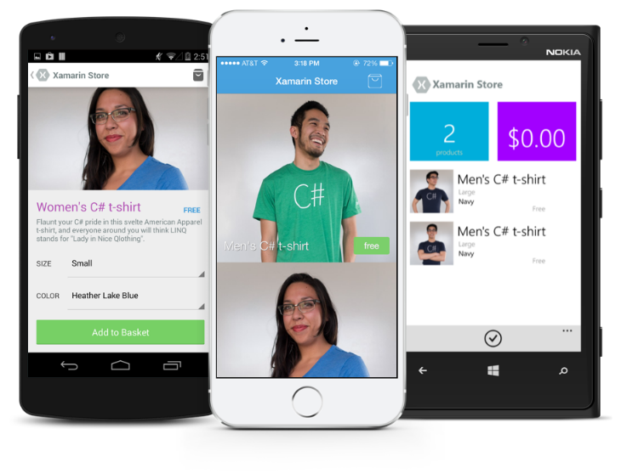
Anything you can do in Objective-C, Swift, or Java can be done in C# and Visual Studio with Xamarin.

Slide 6
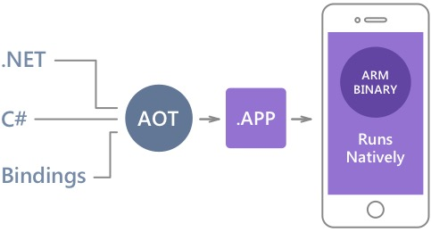
Native Performance
Xamarin.iOS does full Ahead Of Time (AOT) compilation to produce an ARM binary for Apple’s App Store.
Xamarin.Android takes advantage of Just In Time (JIT) compilation on the Android device.

Slide 7
✓Always Up-to-Date
Same-day support:
iOS 5
iOS 6
iOS 7
iOS 7.1
iOS 8
Full support for:
Apple Watch
Google Glass
Android Wear
Amazon Fire TV
and much more
…Usually…

Slide 8
Microsoft buys Xamarin

Slide 9


Slide 10


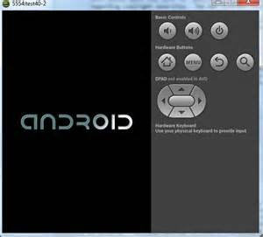

There are a lot of moving parts

Slide 11
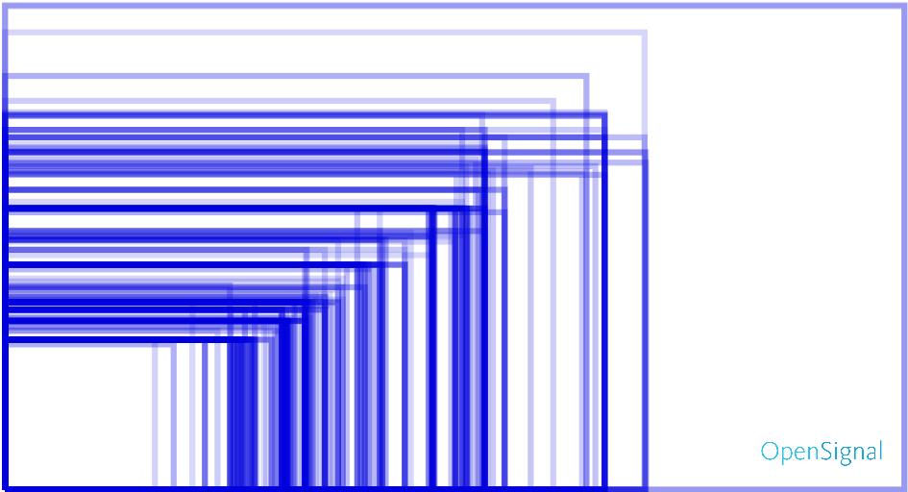
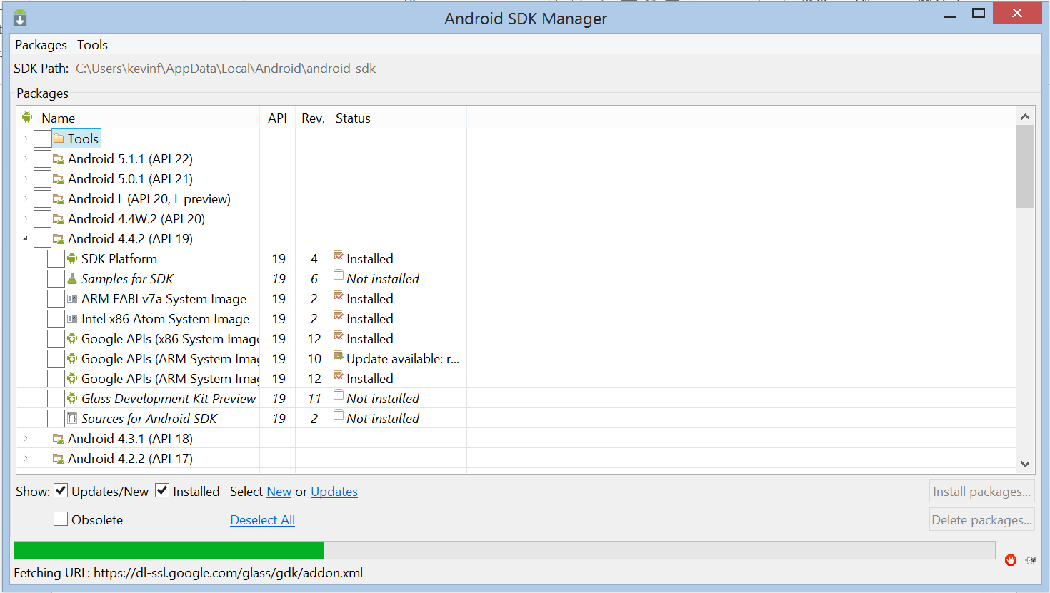
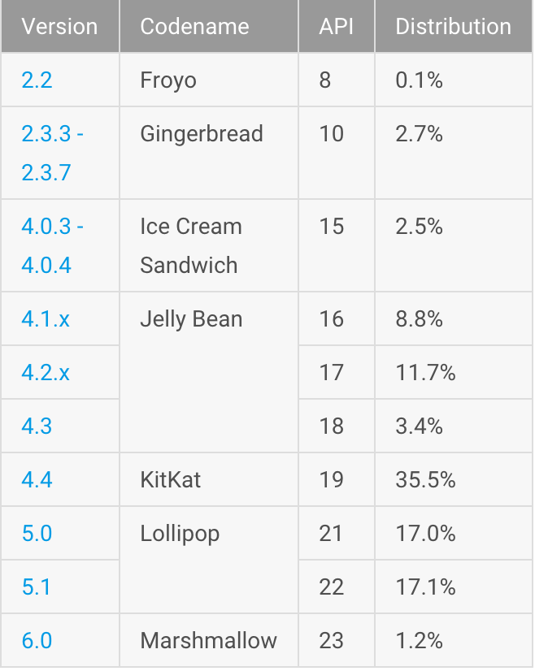

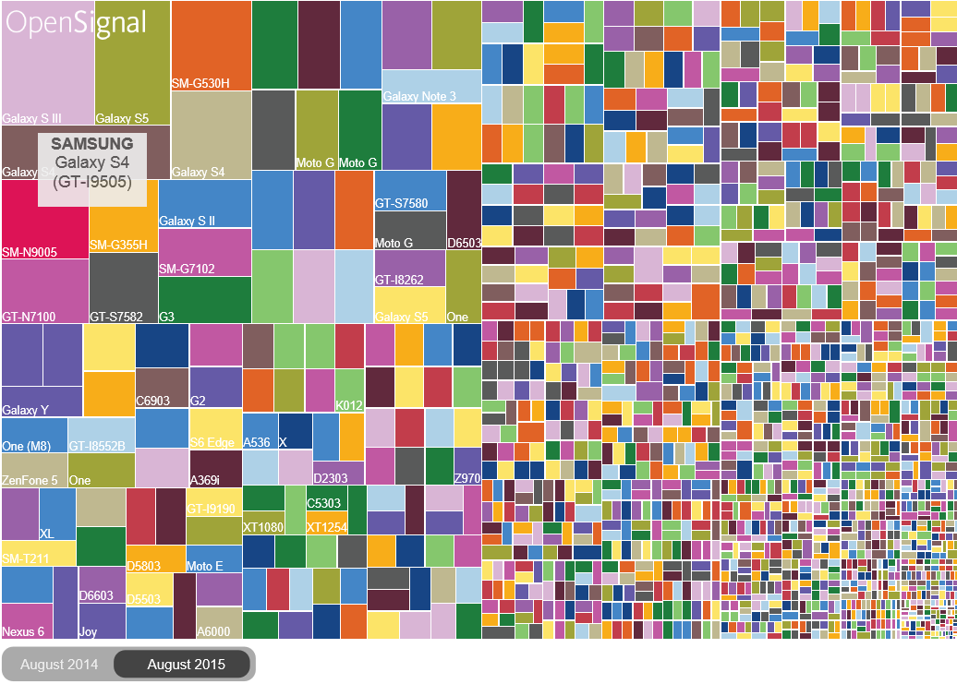
Fragmentation

Slide 12
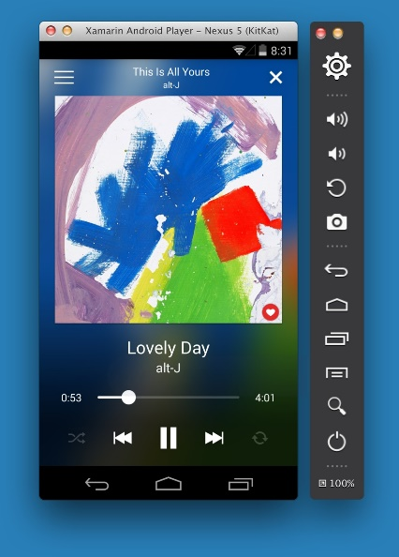
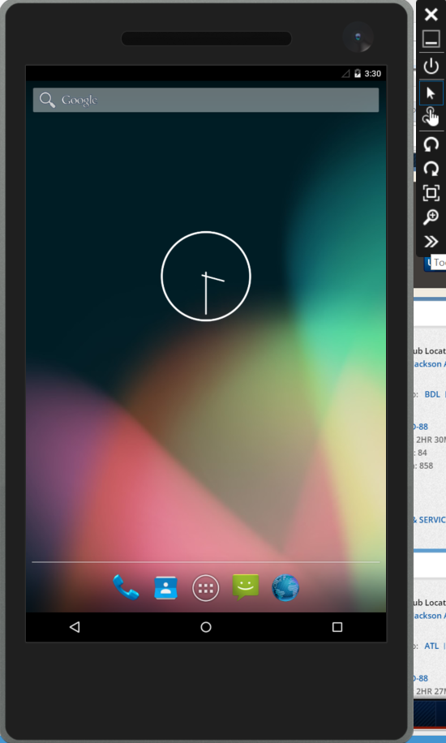
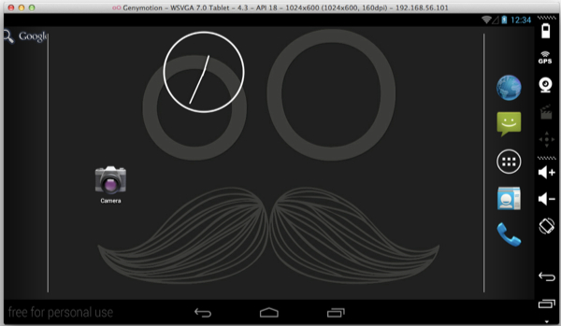
Default Emulator

Slide 13
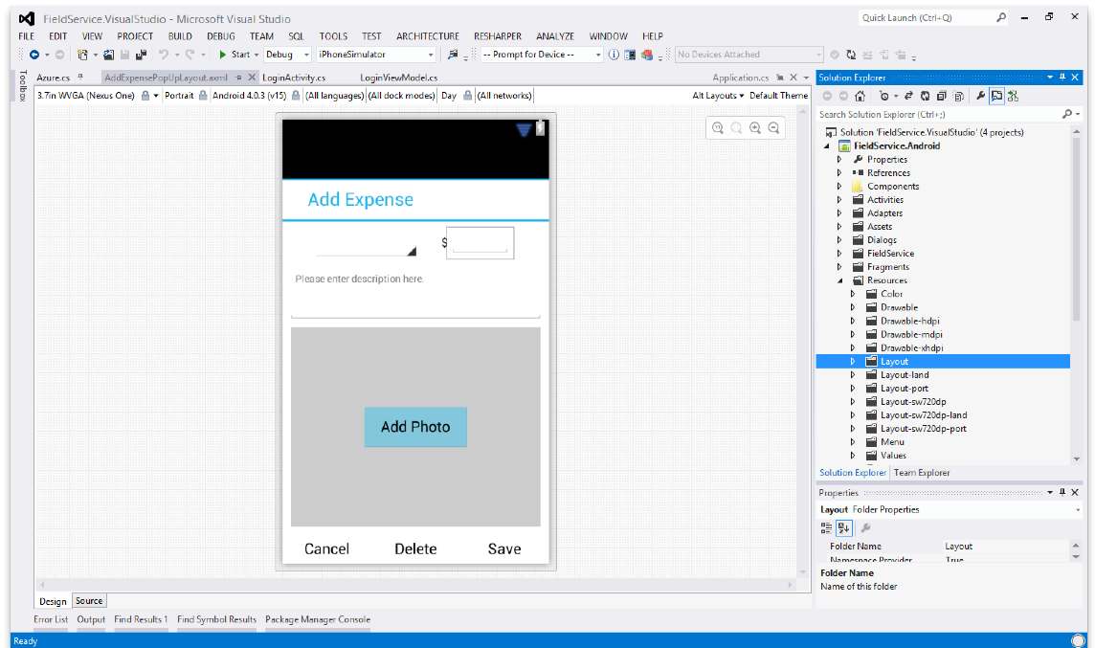
Android Designer
Available in:
Xamarin Studio
Visual Studio
Create UI with drag & drop simplicity
Target multiple screen sizes, resolutions and Android versions
Layouts saved in standard Android XML files

Slide 14

Demo: Creating a New Android Project

Slide 16
Common Layouts
Layouts contained views according to their rules
Linear Layout – stacks contained controls horizontally of vertically.
Relative Layout – Lays out controls relative to each other and the container
WebView – Shows HTML content according to its layout scheme.

Slide 17
Demo: Working with Common Layouts

Slide 18
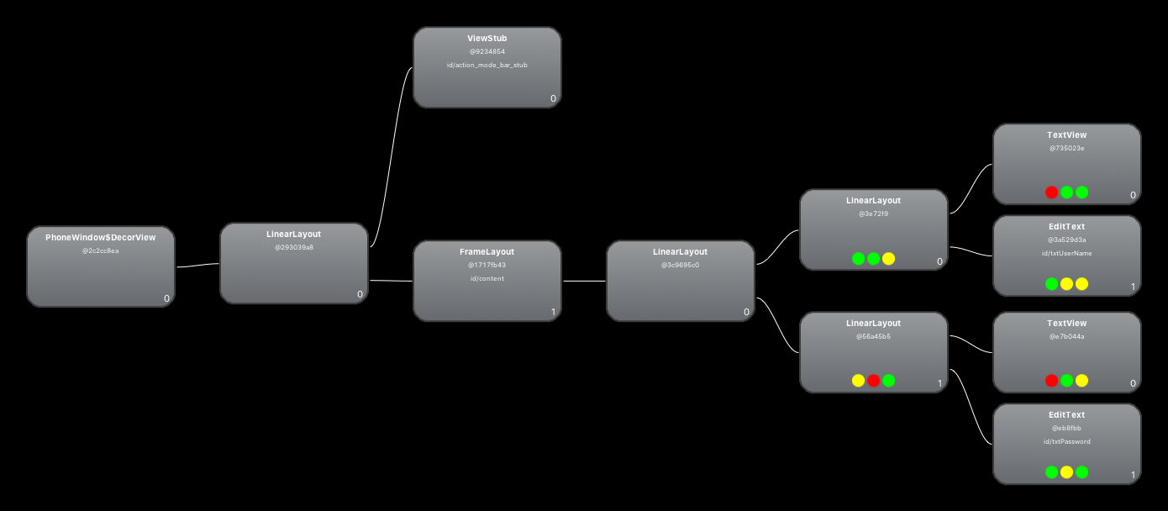

Slide 19
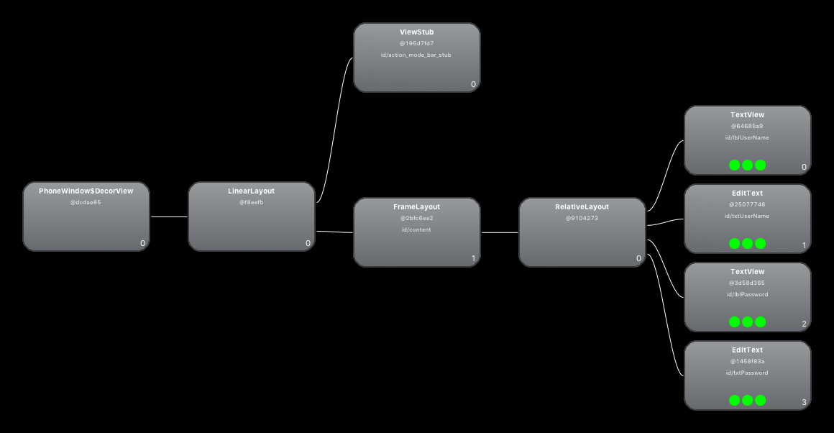

Slide 20
Advanced Layouts
These layouts require an adapter to map the data to the layout
Adapter controls what views are laid out
List View is for large scrolling lists of items
Only the number of views visible + 1 is loaded into memory
Grid views allow for controlling columns as well as rows

Slide 21
Demo: Using a ListView and an Adapter

Slide 23
iOS API - A World of “Kits”

Slide 24
Things you need other than Xamarin

Slide 25
Available in Xamarin Studio and Visual Studio
Follows familiar Visual Studio designer idioms
Supports all UIKit elements
Edit custom and 3rd party components
Live preview of changes to properties

Slide 26
Creating a new iOS Project

Slide 27
UIViewController Lifecycle

Slide 28
Auto Layout And Constraints
Auto layout describes relationships between views, it doesn’t layout automatically
Constraints normally work with:
Width
Height
Centering
Space between edges
Constraints can be handled in code but…
Should consider horizontal and vertical orientations
Constraints can be done in the designer, in code or via the Visual Format language

Slide 29
Segues

Slide 30
Demo – Constraints and Segues

Slide 31
UIListView
Very similar in concept to the Android List View
Also arranges and reuses visible views
Requires an adapter

Slide 32
Demo: Using a UIListView and Adapter

Slide 33
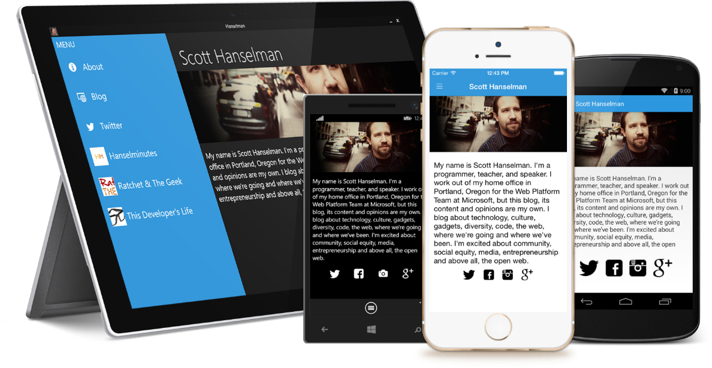
Xamarin Forms
Build native UIs for iOS, Android, and Windows Phone from a single, shared C# codebase using Xaml.

Slide 34
Xamarin + Xamarin Forms
iOS C# UI
Android C# UI
Windows C# UI
Shared UI Code
Shared C# Backend
Shared C# Backend
Traditional Xamarin Approach
With Xamarin.Forms: More code-sharing, all native

Slide 35
What’s included
✓ 40+ Pages, layouts, and controls
(Build from code behind or XAML)
✓ Two-way data binding
✓ Navigation
✓ Animation API
✓ Dependency Service
✓ Messaging Center
Shared UI Code
Shared C# Backend

Slide 36
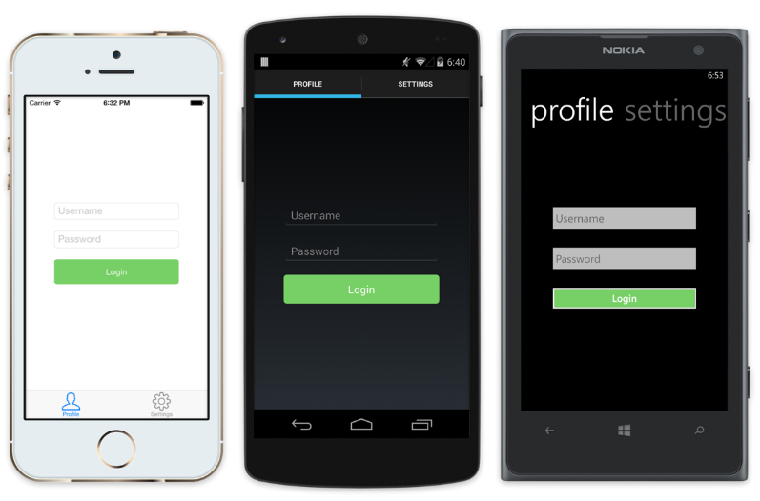
Native UI from shared code
<?xml version="1.0" encoding="UTF-8"?>
<TabbedPage xmlns="http://xamarin.com/schemas/2014/forms"
xmlns:x="http://schemas.microsoft.com/winfx/2009/xaml"
x:Class="MyApp.MainPage">
<TabbedPage.Children>
<ContentPage Title="Profile" Icon="Profile.png">
<StackLayout Spacing="20" Padding="20"
VerticalOptions="Center">
<Entry Placeholder="Username"
Text="{Binding Username}"/>
<Entry Placeholder="Password"
Text="{Binding Password}"
IsPassword="true"/>
<Button Text="Login" TextColor="White"
BackgroundColor="#77D065"
Command="{Binding LoginCommand}"/>
</StackLayout>
</ContentPage>
<ContentPage Title="Settings" Icon="Settings.png">
<!-- Settings -->
</ContentPage>
</TabbedPage.Children>

Slide 37

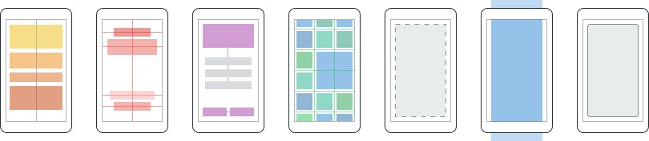
Layouts
Pages
Content
MasterDetail
Navigation
Tabbed
Carousel
Stack
Absolute
Relative
Grid
ContentView
ScrollView
Frame

Slide 38
Creating a New Xamarin Forms Project

Slide 39
Demo: Creating a new Xamarin Forms Project

Slide 40
Xamarin Forms ListView
Similar design and implementation as for Android and iOS
Also uses a form or adapter
Under the covers creates native list types

Slide 41
Demo: Creating a Xamarin Forms Listview

Slide 42
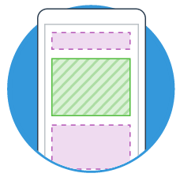


Extensibility
Embed Custom Views Anywhere
Not only are Xamarin.Forms pages mixable with custom screens, you can embed custom views built directly against Xamarin.iOS and Xamarin.Android into Xamarin.Forms pages.
Call Platform APIs via Shared Services
Need platform-specific functionality within a Xamarin.Forms page, such as querying the accelerometer? We’ve included services that quickly and easily abstract platform-specific API calls to keep you writing as much shared code as possible.
Easy migration to the Xamarin Platform
When your native platform integration requirements outgrow Xamarin.Forms, your shared code is easily migrated to Xamarin.iOS and Xamarin.Android using the full Xamarin platform.

Slide 43
Custom Renderers

Slide 44
Demo: Creating a Custom Renderer

Slide 45






Which Xamarin approach is best for your app?
Xamarin.Forms is best for:
Xamarin.iOS / Xamarin.Android is best for:
Data entry apps
Prototypes and proofs-of-concept
Apps that require little platform-specific functionality
Apps where code sharing is more important than custom UI
Apps that require specialized interaction
Apps with highly polished design
Apps that use many platform-specific APIs
Apps where custom UI is more important than code sharing
Learn more: xamarin.com/platform
Learn more: xamarin.com/forms

Slide 46
Links
Examples: https://github.com/Bowman74/VSLiveIntroToXamarin.git

Slide 47
Thank you!
Kevin Ford
Twitter: @Bowman74
kevinf@magenic.com
http://windingroadway.blogspot.com

